Slide 1
The New Real Estate Consumer
May 3, 2012
Joel Singer, CEO, C.A.R.

Slide 2
Outline
The “New” Consumer
California’s Unique Demographics
Home Buyers & Sellers – Experiential Data
Investors
A Generational Buying Opportunity!

Slide 3
Who is the New Real Estate Consumer?
Demographics

Slide 4
CA v. US Population Growth: 1971-2049
Projected
SOURCE: U.S. Census Bureau; California Department of Finance; CALIFORNIA ASSOCIATION OF REALTORS®
Notes:
US:
http://www.census.gov/population/www/projections/summarytables.html
Table 1. Projections of the Population and Components of Change for the United States: 2010 to 2050
CA:
http://www.dof.ca.gov/research/demographic/data/race-ethnic/2000-50/
Data Files – Race/Ethnic Population Totals 2000-2050

Slide 5
Ethnicity Comparisons: US v. CA
Source: U.S. Census Bureau 2010 American Community Survey, NAR 2011 Profile of Home Buyers & Sellers, C.A.R. 2011 Buyer & Seller Surveys

Slide 6
Top 10 CA Home Buyer Surnames
SOURCE: DataQuick Information Systems, 2010

Slide 7
Gender: US v. CA
Sources: 2010 U.S. Census Bureau American Community Survey, 2011 C.A.R. Buyer & Seller Surveys

Slide 8
Median Age: US v. CA
Source: U.S. Census Bureau 2010 American Community Survey, NAR 2011 Profile of Home Buyers & Sellers, C.A.R. 2011 Buyer & Seller Surveys

Slide 9
CA Buyers & Sellers are Getting Younger
Q: What is your age?
Source: C.A.R. 2011 Buyer & Seller Surveys

Slide 10
Household Income: US v. CA
Source: NAR 2011 Profile of Home Buyers & Sellers, C.A.R. 2011 Buyer & Seller Surveys

Slide 11
Buyer & Seller Marital Status: CA v. US CA Has More Alternative Family Structures
Source: U.S. Census Bureau 2010 American Community Survey, NAR 2011 Profile of Home Buyers & Sellers, C.A.R. 2011 Buyer & Seller Surveys

Slide 12
1st-time vs. Repeat Buyers & Sellers
Source: NAR 2011 Profile of Home Buyers & Sellers, C.A.R. 2011 Buyer & Seller Surveys

Slide 13
The Real Estate Transaction as Experienced by Buyers & Sellers

Slide 14
Before the Selling/Buying Process Begins…
Sellers considered selling more than 4 months, on average, before doing so
Buyers considered buying for 4 months before contacting an agent
Buyers investigated for 6 weeks prior to contacting an agent
Source: C.A.R. 2011 Buyer & Seller Surveys

Slide 15
Average Selling Process is Long: 9.5 months
Home listed
Escrow opens
Escrow closes
+7 mos.
+1.5 mos.
Jan.
Aug.
Oct.
Source: C.A.R. 2011 Seller Survey

Slide 16
60% of Sellers Did Not Close Escrow on Time Because…
Loan did not fund on time
Lender did not approve terms
Trouble with buyer’s loan approval
Problems/mistakes on loan documents
Paperwork not completed on time
Walk-through changes not completed
Title company late with recording
Mistakes by other agent
Insurance problems
Escrow company mistake
Source: C.A.R. 2011 Seller Survey

Slide 17
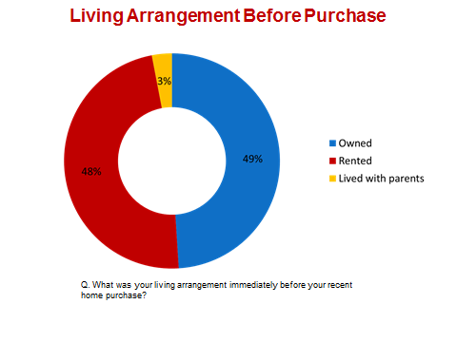
Average Buying Process is Lengthy: 7.5 Months
Consider buying
Investigate homes & neighborhoods
Contact agent
Close escrow
Make an offer
+1.5 mos.
+2.5 mos.
+2 mos.
+1.5 mos.
Jan.
Feb.
May
July
Aug.
View 12 homes with agent
Source: C.A.R. 2011 Buyer & Seller Surveys

Slide 18
Consumers are Doing their Homework Online
77% of sellers & 52% of buyers used social media
51% of buyers Googled their agent
58% of buyers & 66% of sellers found their agents online
Source: C.A.R. 2011 Buyer & Seller Surveys
Notes:
58% buyers found their agent online
51% buyers Googled their agent
66% sellers found their agent on the internet

Slide 19
Most Important Websites for Buyers & Sellers
Q: What was the single most important web site you used in your home selling process?
Source: C.A.R. 2011 Buyer & Seller Surveys

Slide 20
Buyers are Motivated by Affordability Sellers are Motivated by Financial Strains
Top 5 Reasons for Buying
Price decreases (39%)
Favorable price/financing (14%)
Top 5 Reasons for Selling
Could not afford mortgage (22%)
Job/income uncertainty (13%)
Desired better location (14%)
Desired larger home (14%)
Tired of renting (8%)
Loss of household income (12%)
Low prices allowed upgrade (7%)
Mortgage is too expensive (7%)
Source: C.A.R. 2011 Buyer & Seller Surveys

Slide 21
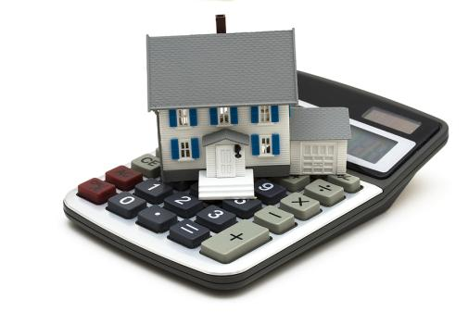
Quick Facts About Buyer Financing
Nearly all (92%) obtained financing, but 72% found it difficult
More than 3 out of 4 (77%) put 20 - 25% down
An overwhelming majority (84%) obtained traditional financing (30-year, fixed-rate loan)
Q. For which of the following did you use the internet as a part of your home buying process?
Source: C.A.R. 2011 Buyer Survey

Slide 22
Overpricing? Average Sale Price is 13% Lower than List Price
Q: What was the initial listing price of your home? Selling price?
Source: C.A.R. 2011 Seller Survey

Slide 23
Expectations About Future Home Prices: Buyers Optimistic – Sellers Pessimistic
In 1 Yr.
In 5 Yrs.
In 10 Yrs.
Q. Do you think home prices in your neighborhood will go up, down, or stay flat in 1 year? 5 years? 10 years?
Source: C.A.R. 2011 Buyer & Seller Surveys

Slide 24
Most Sellers Rent & Don’t Intend to Buy Again
Q: Do you own or rent your current home?
Source: C.A.R. 2011 Seller Survey

Slide 25
Seller Migration
Source: C.A.R. 2011 Seller Survey

Slide 26
94% of Buyers & Nearly 100% of Sellers Used an Agent Because…
Buyers
Most responsive (28%)
Worked with agent before (18%)
1st to respond (17%)
Sellers
1st to respond (21%)
Most responsive (21%)
Most aggressive (19%)
Most aggressive (16%)
Worked with agent before (11%)
Q: What was the single most important reason for selecting the agent you used?
Source: C.A.R. 2011 Buyer & Seller Surveys
Notes:
Clients interviewed 2-3 agents, on average, before making their final selection

Slide 27
Agent Response Time Is Important
Q. Please rate the importance of the agent’s response time in the decision on your final selection on a scale of one to five, with five being extremely important and one being not at all important.
Source: C.A.R. 2011 Buyer Survey
Notes:
Agent response time is important to all buyers.

Slide 28
Buyers Expect Faster Response Time
Q. What was the typical response time you expected from your agent to return any form of communication to you?
Q. On average, what was the actual response time of your agent to return any form of communication to you?
Source: C.A.R. 2011 Buyer Survey
Notes:
Buyer expectations are great and agents are falling short in meeting those response time expectations.

Slide 29
Sellers Also Expect Faster Response
Source: C.A.R. 2011 Seller Survey
Q: On average, what was the ACTUAL time of your agent to return any form of communication to you?
Q: What was the typical response time you EXPECTED from your agent to return any form of communication with you?

Slide 30
Room for Improvement in Agent Response
Q. Did your agent meet your expectations on response time?
Source: C.A.R. 2011 Seller Survey

Slide 31
Agent / Seller Communication Gap
Q: What was your preferred method of communication with your agent?
Q: What was the actual method of communication used most frequently with your agent?
Source: C.A.R. 2011 Seller Survey

Slide 32
Agent / Buyer Communication Gap
Q: What was your preferred method of communication with your agent?
Q: What was the actual method of communication used most frequently with your agent?
Source: C.A.R. 2011 Buyer Survey

Slide 33
Buyer Satisfaction Ratings
Category | Rating
Information on housing market conditions provided by agent | 3.27
Agent’s negotiating skills | 3.20
Assistance provided by agent in searching for a home | 3.39
Professional referrals from agent provided (i.e. lender, inspector, etc.) | 3.12
Value received for what you paid the agent | 3.61
Overall process of finding a home | 3.56
Overall satisfaction with agent | 3.44
Q. Please rate your degree of satisfaction with these aspects of your home buying experience. (Scale: 1= Not at all satisfied, 5=Extremely satisfied)
Source: C.A.R. 2011 Buyer Survey
Notes:
Buyers did not rate any of the categories above a 4, this could be a reflection of dwindling consumer sentiment, poor market conditions and the economic recession.

Slide 34
Buyer Reasons for Satisfaction/Dissatisfaction
Worked hard (55%)
Helped find best home (55%)
Quick to respond (31%)
Negotiated good deal (29%)
Listened to needs (20%)
Slow response (51%)
Communication problems (19%)
Didn’t communicate effectively (14%)
Didn’t negotiate aggressively (12%)
Wasted time with homes I’m not likely to buy (3%)
Q. Why do you have that level of satisfaction with your agent?
Source: C.A.R. 2011 Buyer Survey

Slide 35
Seller Satisfaction Ratings
Category | Mean Rating
Marketing the home | 3.58
Setting the price | 3.39
Assuring the buyer is qualified | 3.13
Time on market before going into escrow | 3.12
Preparing the home for sale | 3.11
Value received for what you paid your real estate agent | 3.07
Negotiating the transaction | 3.04
Escrow closing on time | 2.99
Overall satisfaction with the real estate agent | 2.82
Communications with your agent | 2.72
Overall satisfaction with the home selling process | 2.63
Q: Please rate your degree of satisfaction with your agent for each of the following aspects on a scale of 1 to 5, where 1 is least satisfied and 5 is most satisfied.
Q: Please rate your degree of satisfaction with your agent for each of the following aspects on a scale of 1 to 5, where 1 is least satisfied and 5 is most satisfied.
Source: C.A.R. 2011 Seller Survey

Slide 36
Seller Reasons for Satisfaction/Dissatisfaction
Negotiated good deal
Got the best price for the home
Worked hard
Listened to needs
Quick to respond
Sold home quickly
Kept updated on transaction
House took too long to sell
Didn’t get desired price
Didn’t communicate effectively/efficiently
Q. Why do you have that level of satisfaction with your agent?
Source: C.A.R. 2011 Seller Survey

Slide 37
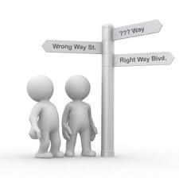
Advice from Buyers to Agents
Gain better understanding of where market is headed
Learn how to handle a distressed property transaction
Respond faster
Communicate how the client wants and better
Gain better understanding of where interest rates are headed
Provide more assistance in acquiring mortgage approval
Negotiate better
Q. What advice would you give to real estate agents to improve the process or the level of service?
Source: C.A.R. 2011 Buyer Survey

Slide 38
Advice from Sellers to Agents
Sell home faster
Improve communication speed
Negotiate more aggressively
Improve communication quality
Market home more aggressively
Price home to sell from start
Gain more expertise in short sales
Provide quality information on market
Listen better
Q: What advice would you give to real estate agents to improve the process or level of service?

Slide 39
Investors

Slide 40
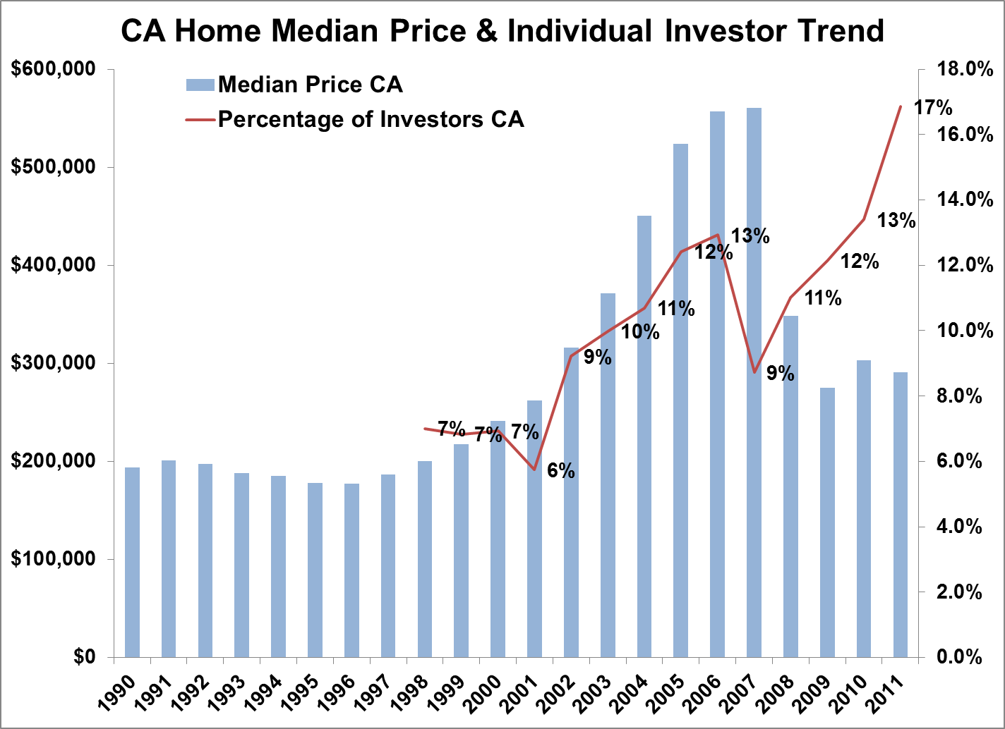
Share of Investors is Growing Rapidly
Source: C.A.R Annual Housing Market Survey
Q: How was/will the property (be) occupied?
Notes:
Over the past 10 years, the percentage of investors in the property buying population has been growing. However, during economic recessions, such as the “Tech Bubble” in the late 1990’s and the recent “Mortgage Crisis” of the late 2000’s, the proportion of residential investors dropped sharply. In 2006, home prices in California peaked, as did the ratio of investors. But with the housing bubble close to bursting, this ratio declined from 13 percent to 9 percent despite of still high home price in 2007Afterwards, the ratio slowly climbed up, largely attributing to the distressed sales price.

Slide 41
Investors Buy Primarily Single-family Homes
Source: C.A.R Annual Housing Market Survey
Q: What type of residence was purchased / sold?
Notes:
Based on C.A.R’s Annual Housing Market Survey, single-family homes are very popular with investment buyers. Over the past eleven years, single-family home purchases have dominated the share of investor purchases, making up between three to 74 times more of overall investment acquisitions, compared to other types of properties.

Slide 42
Investors Prefer Distressed Properties
Source: C.A.R Annual Housing Market Survey
Q from the Survey: Was the property purchased as a(n)?
Notes:
Although traditional sales almost dominate in the all transactions, REO sales and short sales comprised a significant part of investment transactions since housing bubble burst in 2007.

Slide 43
Popular Destinations/Largest Markets
L.A.
San Diego
Riverside
Source: C.A.R Annual Housing Market Survey
Q : In what country was the property located?
Notes:
The majority of investment properties are located in Los Angeles, San Diego and Riverside Counties. Most of those counties are typically priced relatively higher than others and have good potential for future appreciation in value.

Slide 44
Investors Buy Below the Median
Source: C.A.R Annual Housing Market Survey
Q: What was the final sales price of the property?
Notes:
Meanwhile, the sales price of investment properties remained low during 2001 recession, increased with the booming housing market from 2004 through 2008, and plunged to $232,750 in 2009, only slightly above the 2000 price of $220,000. Compared to the median price of all sales in California, residential investors were generally looking for the properties at a substantially low price in the hope of large spread in the future.

Slide 45
…and Pay All Cash!
Source: C.A.R Annual Housing Market Survey
Q: What was the nature of the financing arrangement?
Notes:
In recent years, investment transactions have involved more and more cash sales. The ratio reached 68 percent in 2010. In contrast, newly original first mortgage sales went from 74 percent in 2006 down to 31 percent in 2010.

Slide 46
A Once-in-a-Generation Buying Opportunity!

Slide 47
Economy Showing Signs of Improvement
Up
Disposable Income
Personal spending
Down
Personal savings
Unemployment
Consumer confidence
Inflation
Notes:
Personal spending is up
Unemployment is down
Consumer confidence is up
Retail sales are bouncing back
Inflation is up
Personal savings down

Slide 48
Housing Market Demonstrating Stability
Mortgage rates
Median price
Foreclosures
Foreclosure inventory
Sales
Affordability
Notes:
Mortgage rates @ historical lows
Sales are bouncing back
Median price is down
Affordability is up
Unsold inventory is holding steady
Time on market hovering between 50 and 60 days
Foreclosures declining
Foreclosure inventory down Y-T-Y

Slide 49
Recent Headlines
“New Real Estate Poll: Americans Increasingly Optimistic about Homeownership”
~RISMedia 3/15/12
“Investors Are Looking to Buy Homes by the Thousands”
~The New York Times 4/2/12
“Pending home sales near 2-year high”
~Inman News 4/26/12
“Housing market may be on rebound at last”
~Los Angeles Times 4/25/12

Slide 50
Buy vs Rent Analysis: $3,760 a Year Cheaper to Buy in CA
Source: C.A.R. 9/11 Analysis
Notes:
Compares mortgage (principal, interest, taxes & insurance) & tax savings vs. rent

Slide 51
“Top 5 Reasons it’s Smarter to Buy than Rent”
Real estate keeps pace with/exceeds inflation
Lowest interest rates since 1950’s
Increasing interest rates add up fast/questionable future availability
Certain Markets have already bottomed
Forced Savings Build wealth
Source: Inman News 3-26-12

Slide 52
Mortgage Rates at Record Lows
SOURCE: Federal Home Loan Mortgage Corporation
Notes:
Mortgage rates continue to be low as rates in general have responded both to the Fed’s “twist” policy to uncertainty regarding the US and global economic situation.
SOURCE:
Fed funds - Haver Analytics
FRM: http://www.freddiemac.com/pmms/pmms30.htm
ARM: http://www.freddiemac.com/pmms/pmmsarm.htm

Slide 53
Housing Affordability Index CA vs. U.S. Annual Rate
% OF HOUSEHOLDS THAT CAN BUY
SOURCE: CALIFORNIA ASSOCIATION OF REALTORS®

Slide 54
California vs. U.S. Median Prices CA Return on Investment by Year of Purchase
1061%
SOURCE: CALIFORNIA ASSOCIATION OF REALTORS®
SOURCE: CALIFORNIA ASSOCIATION OF REALTORS®

Slide 55
Disposable Income Expected to Rise

Slide 56
Key Conclusions
Capture more clients with a strong internet presence
Beat the competition by being responsive and aggressive
Have reliable lender references to assist buyers with financing
Take the free advice from clients to improve your business

Slide 57
Thank You!

